Slide 1
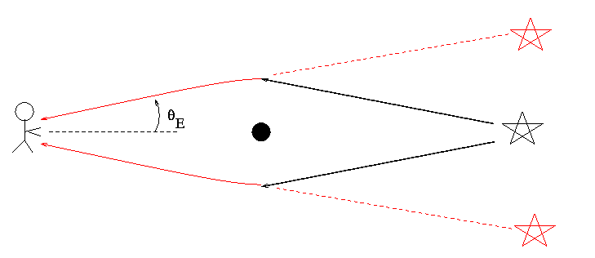
Gravitational Lensing
Magnification of distant sources
Einstein ring if perfect alignment
More likely to observe 2 arcs centred on lens
Azimuthal angle of images constant regardless of source angle

Slide 2
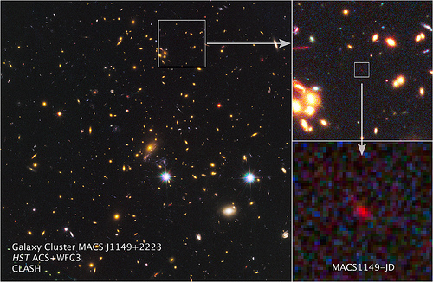
Option 1: Known Lenses
Limited number known ~50
Known mass, velocity dispersion and radius
Cluster Lensing And Supernova survey with Hubble (CLASH)
25 x-ray selected clusters
Found a lensed candidate z=11.9 galaxy
MAssive Cluster Survey (MACS)
On-going survey
So far >100 spectroscopically confirmed clusters at 0.3 ≤ z ≤ 0.7

Slide 3
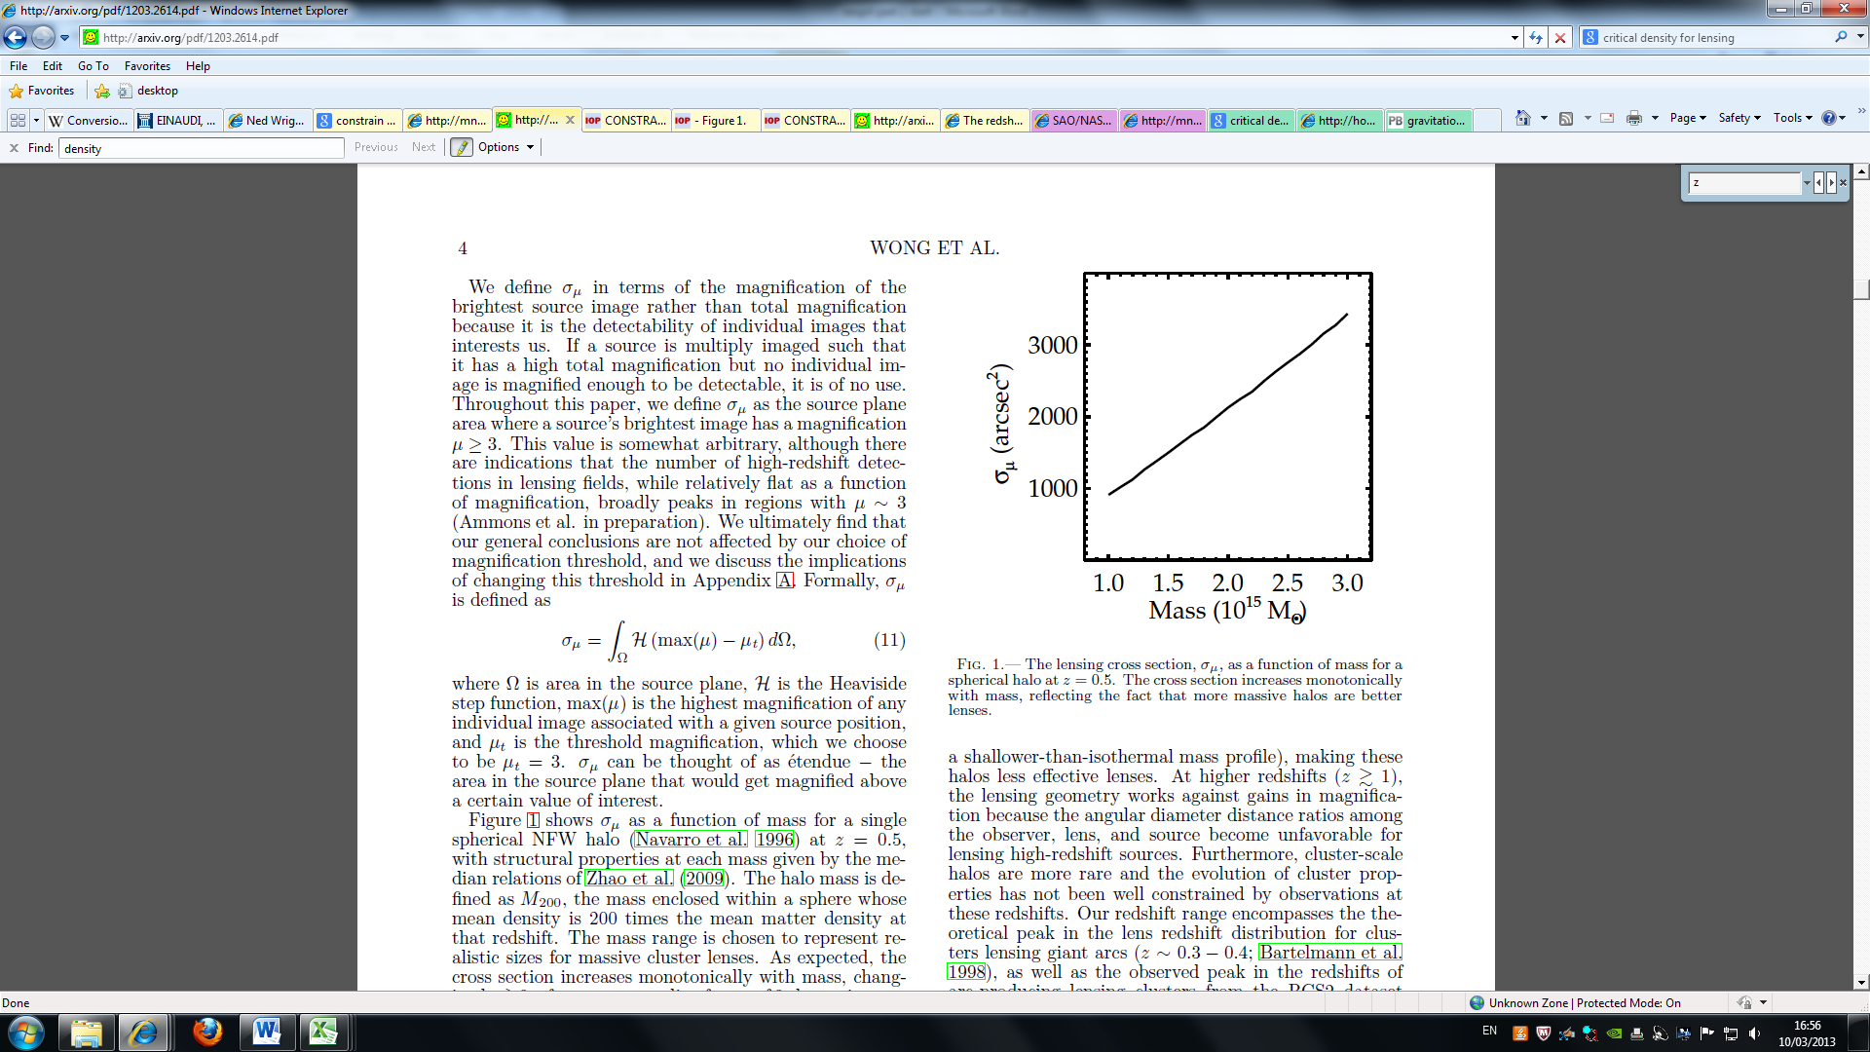
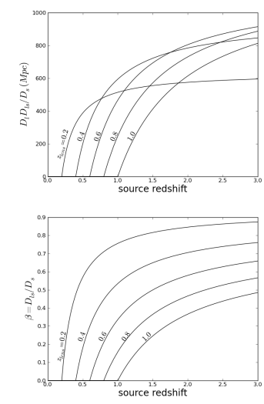
Option 2: Locate New Lenses
Select using strong lensing
Specific selection criteria
Area of sky
Away from bright contaminants
Compatible with telescopes
Redshift range
Shear (shape distortion) is greater at higher lens redshifts
Einstein angle greater at lower lens redshifts
Optimum around z=0.6

Slide 4
Gravitational Lensing Summary
Trade off between viewing area and source magnification
Use lensing to supplement deep survey

